Slide 1
Semantic Segmentation in Dusk lighting
By
Mehul Lakra
Joy Mathew Gunasekar

Slide 2
Introduction
We replicated 2 papers (Unsupervised image to image translation network and BiSeNet-v2).
Our project focuses on testing semantic segmentation models (BiSeNetv2) in darker conditions.
We replicated the existing BiSeNetv2 model and tested it using our modified dataset.
We further experiment with image processing techniques to potentially improve the capabilities of the overall segmentation model.

Slide 3
Problem Statement
Autonomous driving systems need to be robust in various conditions.
Semantic segmentation helps these systems understand their surroundings.
Existing semantic segmentation models have limited capabilities in darker conditions, which can be a safety concern.
These models are also impacted by flaws such as blurring and noise.

Slide 4
Overview
We used the UNIT model to generate a modified dataset with low-light images.
We replicate the BiSeNet-v2 model with the modified dataset to observe the degradation in performance.
Possible solutions which can potentially improve the accuracy of semantic segmentation in these unsuitable conditions.
Deblurring and Denoising on the fly while inference.
Training entirely with the Modified Dataset.

Slide 5
Technical Details
The UNIT model was pre-trained on the CAMVID dataset which was used to convert our dataset to low-light images.
The BiSeNetv2 model is a deep neural network used for semantic segmentation.
We faced technical challenges during data preprocessing and training, which we overcame by testing and experimentation.

Slide 6
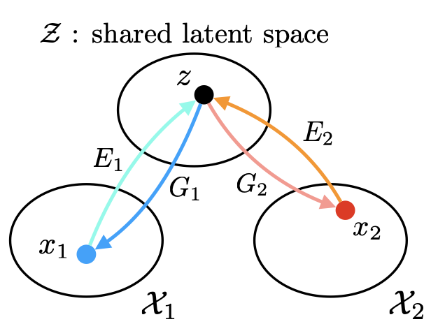
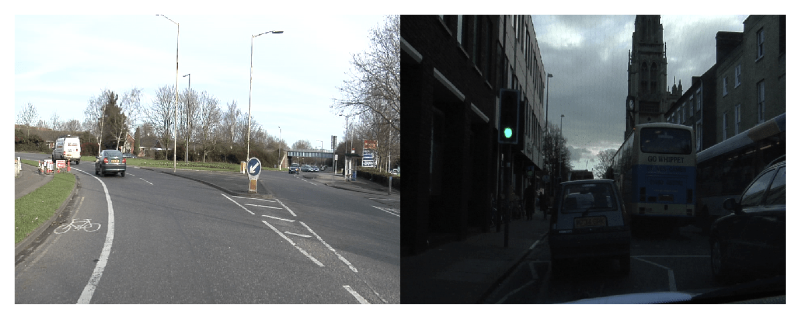
UNIT
For day to dusk conversion of images we plan on using (UNIT) Unsupervised image to image translation network.
UNIT is a type of generative adversarial network that consists of two discriminators and one generator, we can train them simultaneously to improve performance.
We use latent space estimation as assumption to estimate joint distribution of images in different domains.
In latent space assumption specifically we assume that given any pair of corresponding images in the two domains there exists a share namespace Z and a pair of encoding functions E1 and E2 so that the two images can be mapped to the same they encode and there also exists a pair of generation functions G 1 and G 2 that can map the land code back to the two images
Notes:
so for dawn to dusk transition we used UNIT, there are also other algorithms that could do this eg- cycle gan, but we ultimately went with UNIT because it is unsupervised.

Slide 7
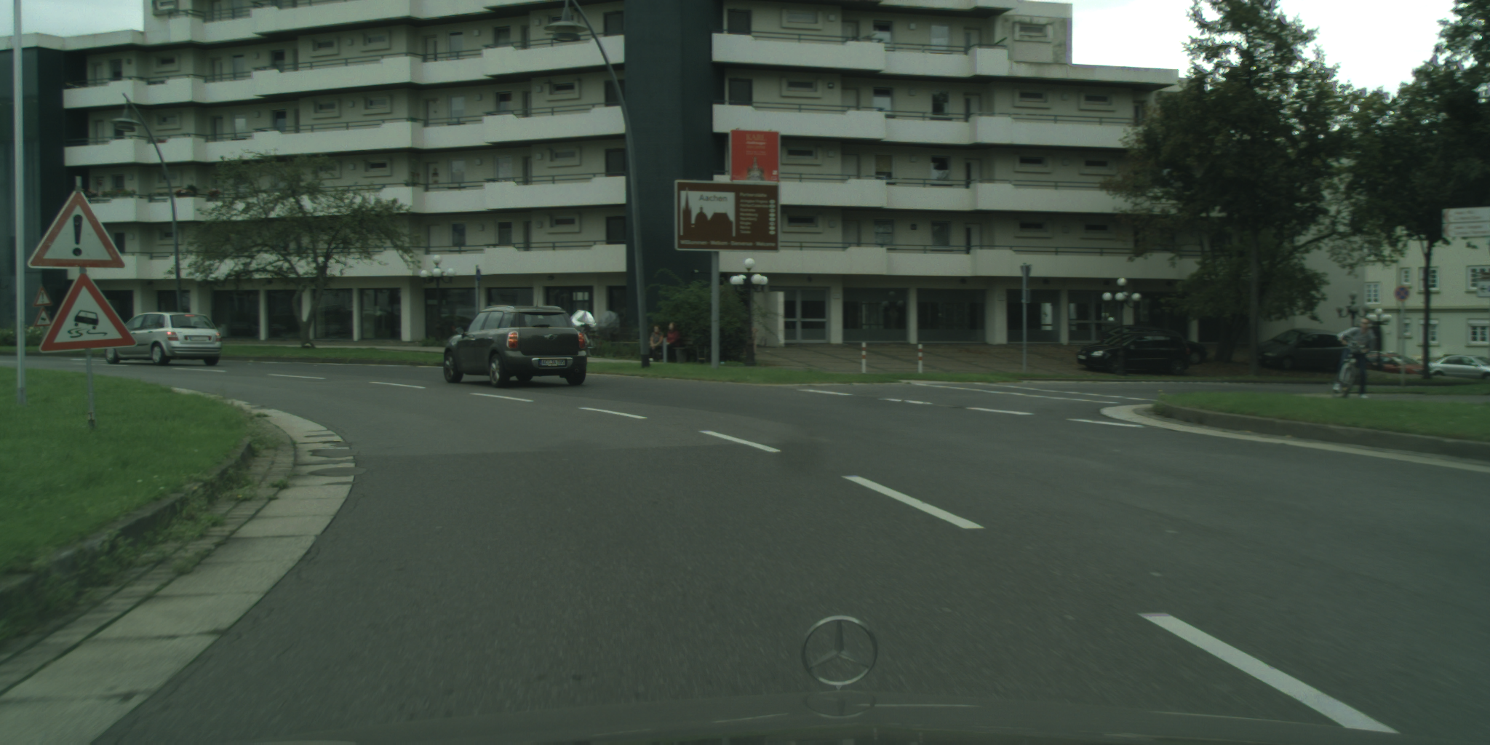
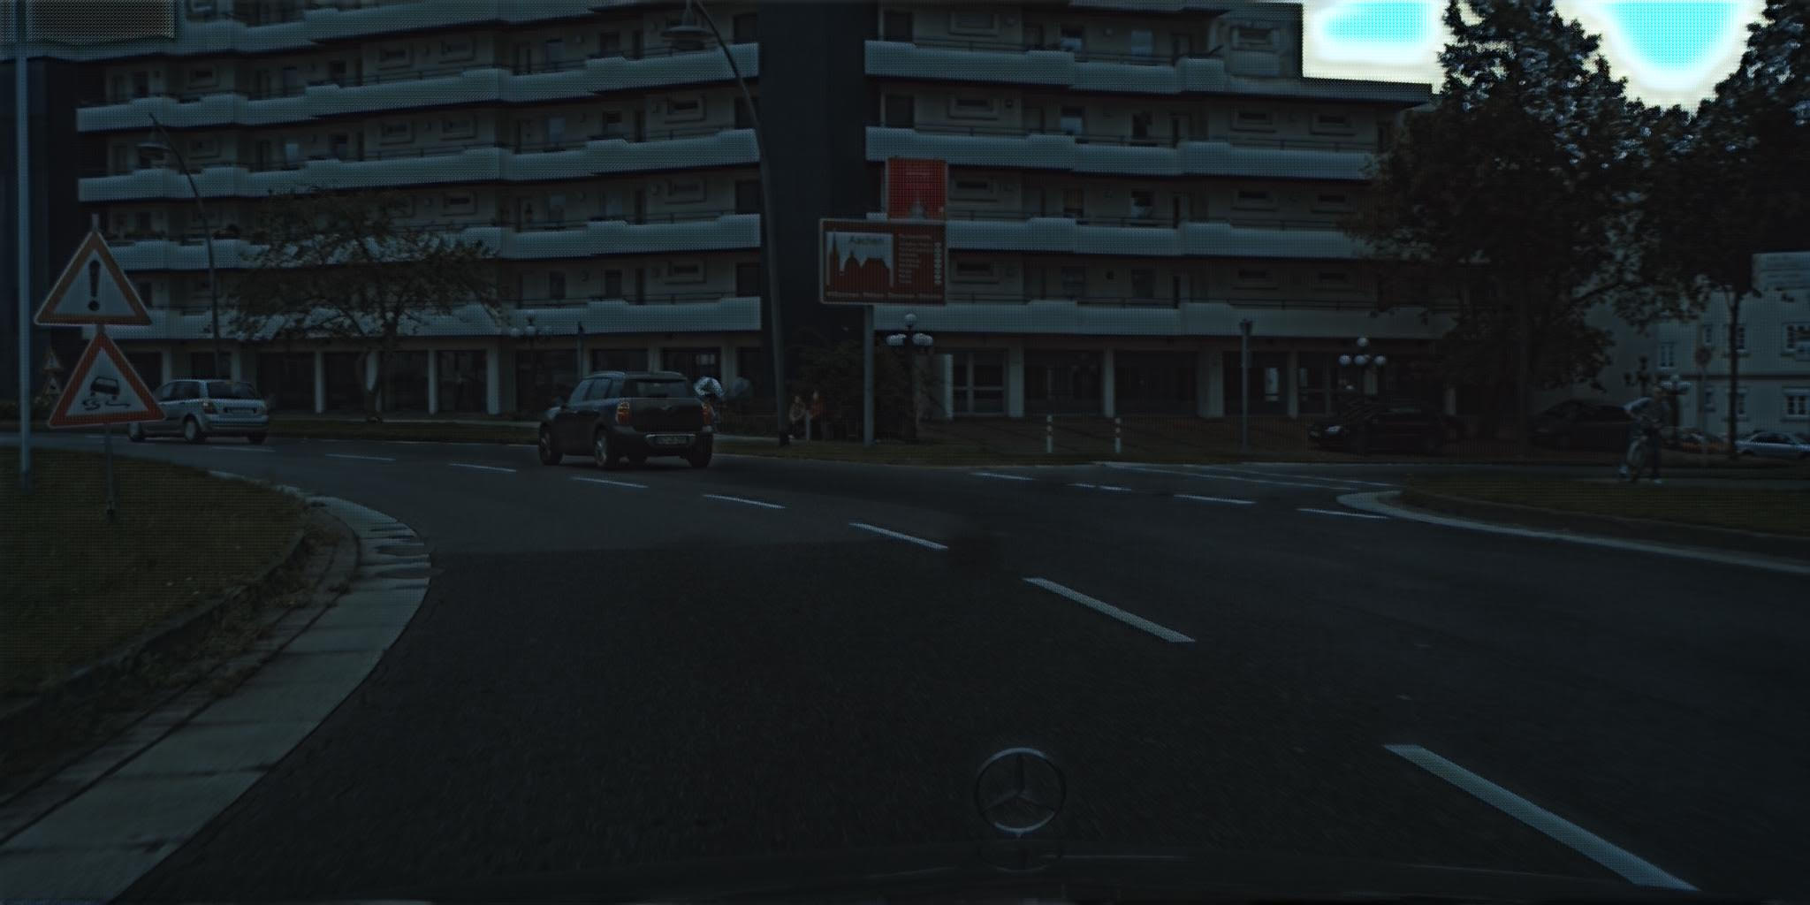

Slide 8
BiSeNet-v2
BiSeNetv2 uses a two-pathway network architecture, which consists of a high-resolution pathway and a low-resolution pathway.
The high-resolution pathway is responsible for capturing fine-grained details in the image, while the low-resolution pathway captures global context.
The model also uses a Spatial Path Augmentation (SPA) module, which adds spatial information to the feature maps, and a Context Path Augmentation (CPA) module, which adds contextual information to the feature maps.
These modules allow the model to effectively capture both local and global information in the image, and to perform accurate segmentation even on small objects.
BiSeNetv2 also incorporates a feature fusion module that combines the feature maps from both pathways, as well as a feature refining module that further refines the features for better accuracy.
The model is trained using a combination of supervised and unsupervised learning, which allows it to learn from both labeled and unlabeled data and to generalize well to new images.
Overall, BiSeNetv2 is a highly efficient and accurate model for semantic segmentation, and has achieved state-of-the-art performance on several benchmark datasets.

Slide 9
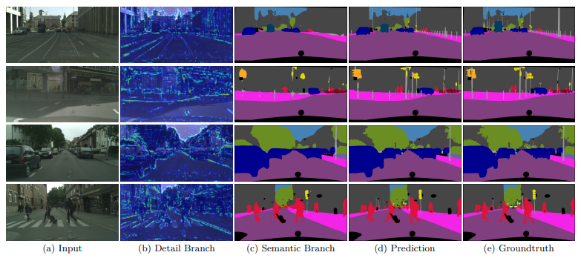
BiSeNet-v2

Slide 10
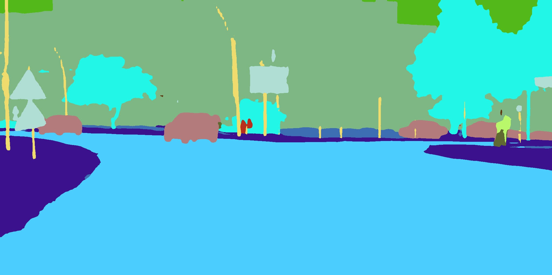
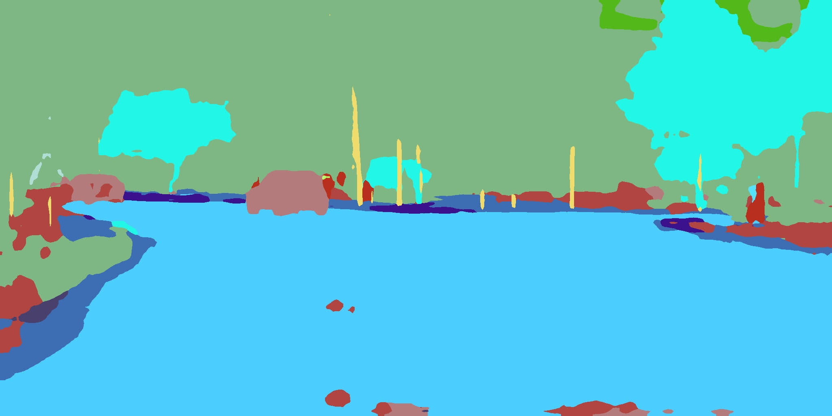

Slide 11
Results and Impact
Our system: i7 12700H, RTX 3070, 16GB RAM
As we saw earlier the model does not perform well in low-light conditions which could lead to several safety hazards in a real world scenario.

Slide 12
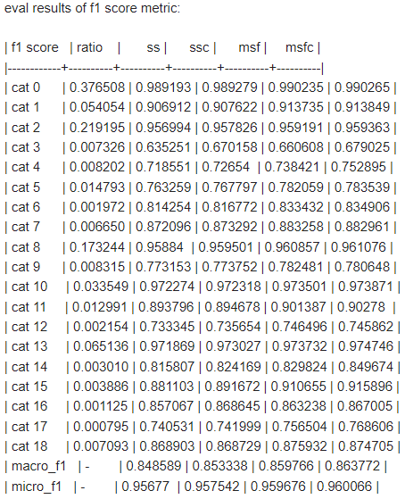
F1 Score Metrics

Slide 13
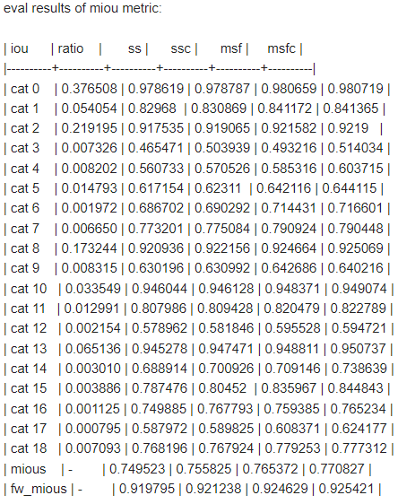
MIOU Metrics

Slide 14
Conclusion and Future Work
Training semantic segmentation models in darker conditions is crucial for improving their capabilities and performance.
In the future, we plan to explore other approaches to improving semantic segmentation in low-light conditions and other undesirable condition.

